Slide 1
Artificial Intelligence: Concepts, Applications, and Future Directions

Slide 2

Slide
Title: Artificial Intelligence: Concepts, Applications, and Future Directions

Slide 3

Introduction to AI
AI enables machines to perform human-like tasks.
These tasks include learning, problem-solving, and decision-making.
AI uses various computational techniques.

Slide 4

Machine Learning (ML)
ML is a core subfield of AI.
ML algorithms learn from data without explicit programming.
Performance improves through experience on a specific task.

Slide 5

Deep Learning (DL)
DL is a specialization within machine learning.
It uses deep artificial neural networks.
These networks analyze complex data structures.
Enables breakthroughs in image/language/speech.

Slide 6

Natural Language Processing (NLP)
NLP allows machines to understand and generate human language.
Applications include machine translation and sentiment analysis.
Also includes chatbot development and text summarization.

Slide 7

Computer Vision
Computer vision allows machines to "see" and interpret visual data.
Machines can identify objects and track movements.
Applications include autonomous vehicles and medical imaging.
Also used in security systems.

Slide 8
Reinforcement Learning (RL)
RL trains agents to make decisions in an environment.
Agents maximize a cumulative reward.
Mimics human learning through trial and error.
Used in robotics, game playing, and resource management.

Slide 9

Code Example
import random
def simple_q_learning(states, actions, learning_rate=0.1, discount_factor=0.9, episodes=1000):
q_table = {}
for s in states:
q_table[s] = {}
for a in actions:
q_table[s][a] = 0.0
for _ in range(episodes):
state = random.choice(states)
action = random.choice(actions)
reward = 1 if state == 'A' and action == 'Right' else 0 # Example reward function
next_state = 'B' if state == 'A' and action == 'Right' else state
best_next_q = max(q_table[next_state].values())
q_table[state][action] += learning_rate * (reward + discount_factor * best_next_q - q_table[state][action])
return q_table
states = ['A', 'B']
actions = ['Left', 'Right']
q_table = simple_q_learning(states, actions)
print(q_table)

Slide 10
Code Example
import random def simple_q_learning(states, actions, learning_rate=0.1, discount_factor=0.9, episodes=1000): q_table = {} for s in states: q_table[s] = {} for a in actions: q_table[s][a] = 0.0 for _ in range(episodes): state = random.choice(states) action = random.choice(actions) reward = 1 if state == 'A' and action == 'Right' else 0 # Example reward function next_state = 'B' if state == 'A' and action == 'Right' else state best_next_q = max(q_table[next_state].values()) q_table[state][action] += learning_rate * (reward + discount_factor * best_next_q - q_table[state][action]) return q_table states = ['A', 'B'] actions = ['Left', 'Right'] q_table = simple_q_learning(states, actions) print(q_table)

Slide 11
Code Example
import random def simple_q_learning(states, actions, learning_rate=0.1, discount_factor=0.9, episodes=1000): q_table = {} for s in states: q_table[s] = {} for a in actions: q_table[s][a] = 0.0 for _ in range(episodes): state = random.choice(states) action = random.choice(actions) reward = 1 if state == 'A' and action == 'Right' else 0 # Example reward function next_state = 'B' if state == 'A' and action == 'Right' else state best_next_q = max(q_table[next_state].values()) q_table[state][action] += learning_rate * (reward + discount_factor * best_next_q - q_table[state][action]) return q_table states = ['A', 'B'] actions = ['Left', 'Right'] q_table = simple_q_learning(states, actions) print(q_table)

Slide 12

Expert Systems
Expert systems emulate human experts' decision-making.
They use a knowledge base of rules and information.
Provides advice or solutions within specific domains.
An early form of AI.

Slide 13
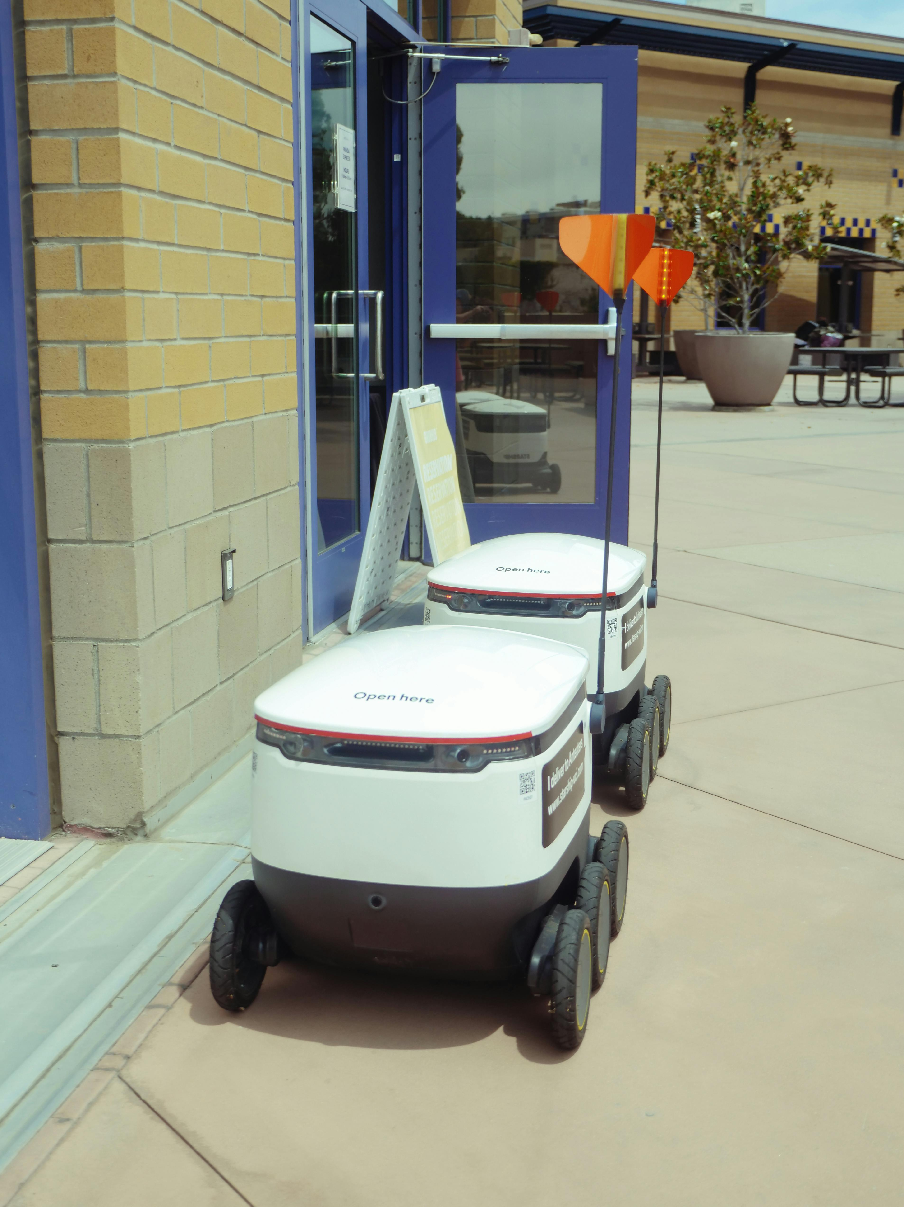
Ethical Considerations in AI
AI development raises ethical concerns.
This includes bias in algorithms.
Also considers job displacement due to automation.
Privacy concerns regarding data collection and usage.
Potential misuse of AI for malicious purposes.

Slide 14

Explainable AI (XAI)
XAI aims to create transparent AI models.
Provide understandable explanations for decisions.
Increases trust and accountability.
Important in healthcare and finance applications.

Slide 15

Future Research Directions
Developing more robust and generalizable AI systems.
Exploring new architectures and algorithms.
Addressing societal and ethical implications.
Requires increasingly intelligent machines.

Slide 16
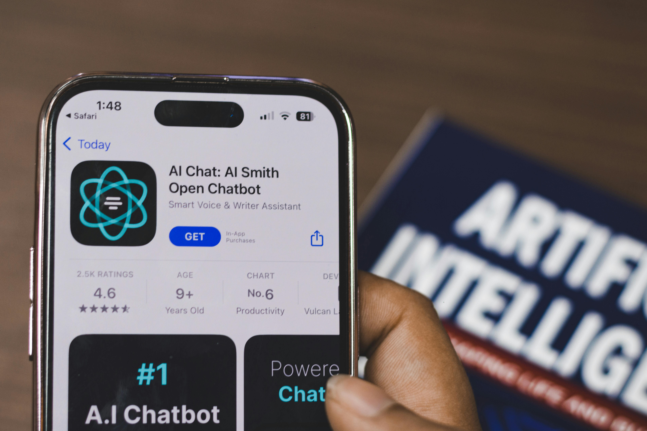
Generative AI
Generative AI models create new content.
Examples include GANs and transformers.
Generate images, text, and music.
Opens possibilities for creative applications.
Used for data augmentation.

Slide 17

AI Applications Across Industries
AI is transforming various industries.
Healthcare: improved diagnostics, personalized treatments.
Finance: fraud detection, algorithmic trading.
Manufacturing: robotic automation, predictive maintenance.

Slide 18

Cognitive Computing
Cognitive computing simulates human thought processes.
Uses self-learning systems.
Utilizes data mining, NLP, and pattern recognition.
Solves complex problems.

Slide 19
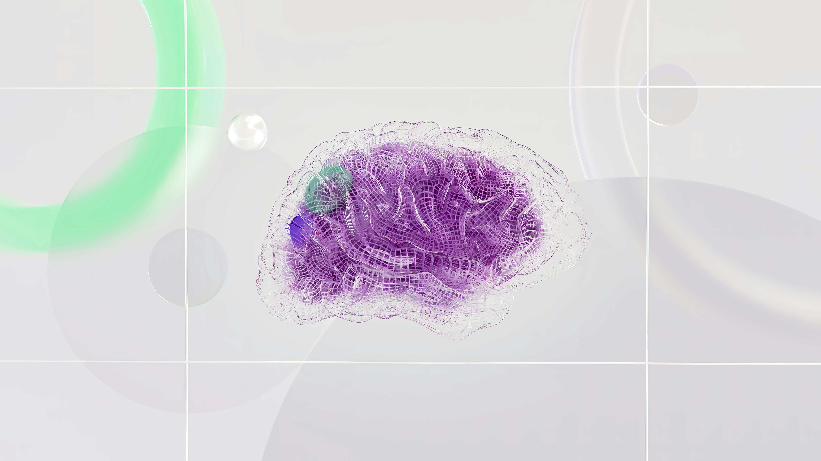
The Turing Test
Proposed by Alan Turing.
Represents a benchmark for machine intelligence.
Assesses ability to exhibit human-equivalent behavior.
Remains a significant milestone in AI.

Slide 20
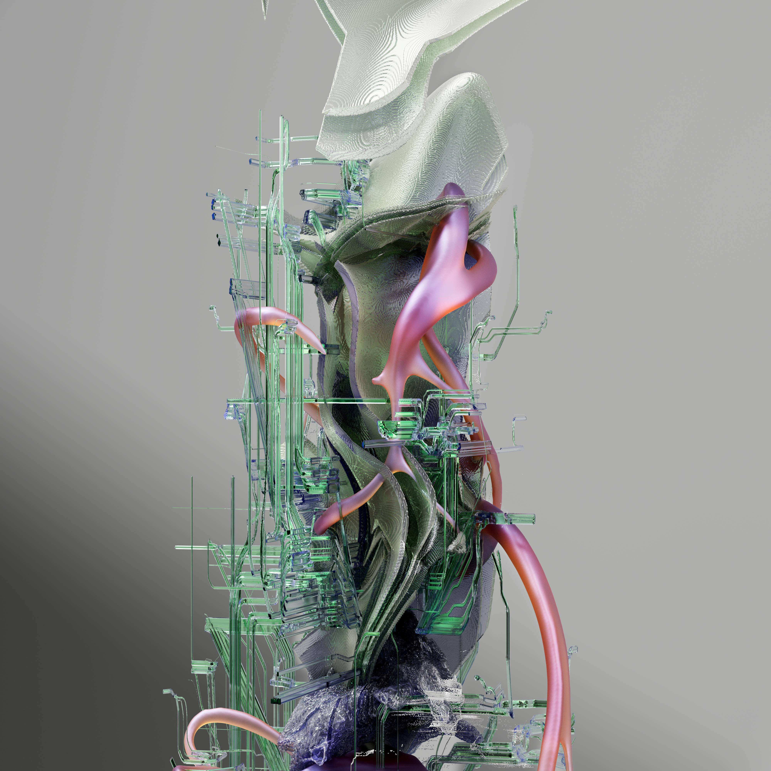
Symbolic AI (GOFAI)
Focuses on representing knowledge using symbols and rules.
Enables logical reasoning and problem-solving.
Struggles with perception and pattern recognition.

Slide 21
Connectionist AI
Emphasizes using artificial neural networks.
Networks learn from data.
Mimics the human brain's structure and function.
Effective for image recognition and NLP.

Slide 22
Data and Resources
AI success depends on large datasets for training.
Requires significant computational resources.
Needed to process data and train complex algorithms.

